Slide 1


Huazhong University of Science and Technology
The Department of Electronics and Information Engineering
Electronic Circuit Analysis and Design
Dr. Tianping Deng
Email: dengtp@hust.edu.cn

Slide 2
Contents
PART 1 SEMICONDUCTOR DEVICES AND BASIC APPLICATIONS
Chapter 1 Semiconductor Materials and Diodes
Chapter 2 Diode Circuits
Chapter 3 The Field-Effect Transistor
Chapter 4 Basic FET Amplifiers
Chapter 5 The Bipolar Junction Transistor
Chapter 6 Basic BJT Amplifiers
Chapter 7 Frequency Response
Chapter 8 Output Stages and Power Amplifiers
PART 2 ANALOG ELECTRONICS
Chapter 9 Ideal Operational Amplifiers and Op-Amp Circuits
Chapter 10 Integrated Circuit Biasing and Active Loads
Chapter 11 Differential and Multistage Amplifiers
Chapter 12 Feedback and Stability
Chapter 13 Operational Amplifier Circuits
Chapter 14 Nonideal Effects in Operational Amplifier Circuits
Chapter 15 Applications and Design of Integrated Circuits
Chapter 15 Applications and Design of Integrated Circuits

Slide 3
Chapter 15: Applications and Design of Integrated Circuits
15.0 Preview
15.1 Active Filters
15.2 Oscillators
15.3 Schmitt Trigger Circuits
15.4 Nonsinusoidal Oscillators and Timing Circuits
15.5 Integrated Circuit Power Amplifiers
15.6 Voltage Regulators
15.7 Summary

Slide 4
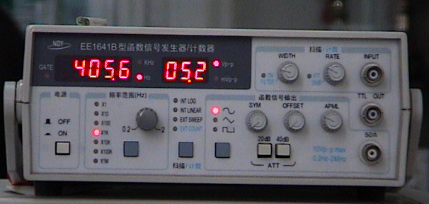

15.2 Sinusoidal Oscillators

Slide 5
15.2 Sinusoidal Oscillators
15.2.1 Basic Principles for Oscillation
15.2.2 Phase-Shift Oscillator
15.2.3 Wien-Bridge Oscillators

Slide 6
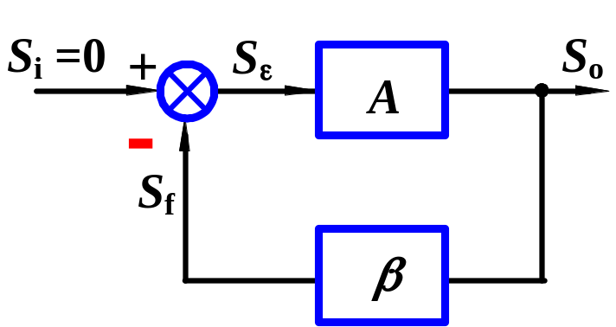
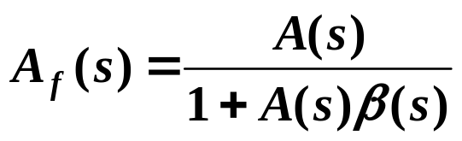



15.2 Oscillators
15.2.1 Basic Principles for Oscillation
1. Condition of Oscillation
Oscillator block diagram shown in fig. Closed-loop gain
When loop gain
S_{o} also has output signal without input.
Conditions for sustained oscillations
Condition of magnitude
Total phase must be 2nπ
Condition of phase shift

Slide 7
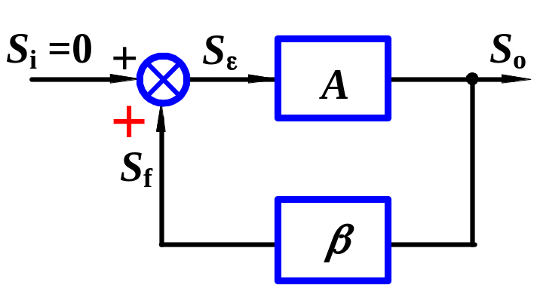

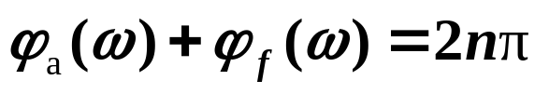
15.2 Oscillators
15.2.1 Basic Principles for Oscillation
1. Condition of Oscillation
If connect a positive feedback.
Conditions for sustained oscillations
Condition of magnitude
Condition of phase shift

Slide 8
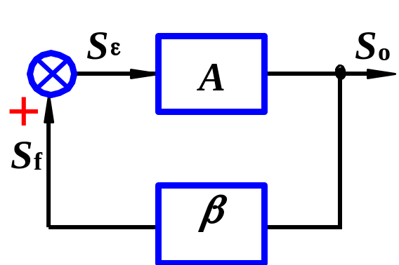

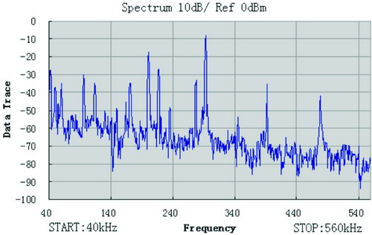
2. To Start Oscillator and Stabilize
Condition to start oscillator
# Oscillator only has output terminal, it can start to oscillate at the desired frequency without input signal, where does this signal come from?
Random noise can cause oscillations to begin.

Slide 9
2. To Start Oscillator and Stabilize
Condition to start oscillator
The desired freq. ω_{o} in noise has 2nπ phase shift, and can be amplified to produce output signal.
Increasing amplitude of output voltage should be limited before distortion occurs.

Slide 10
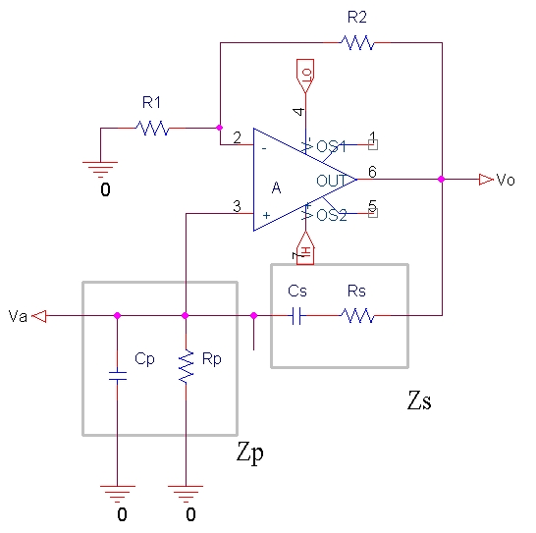

Slide 11
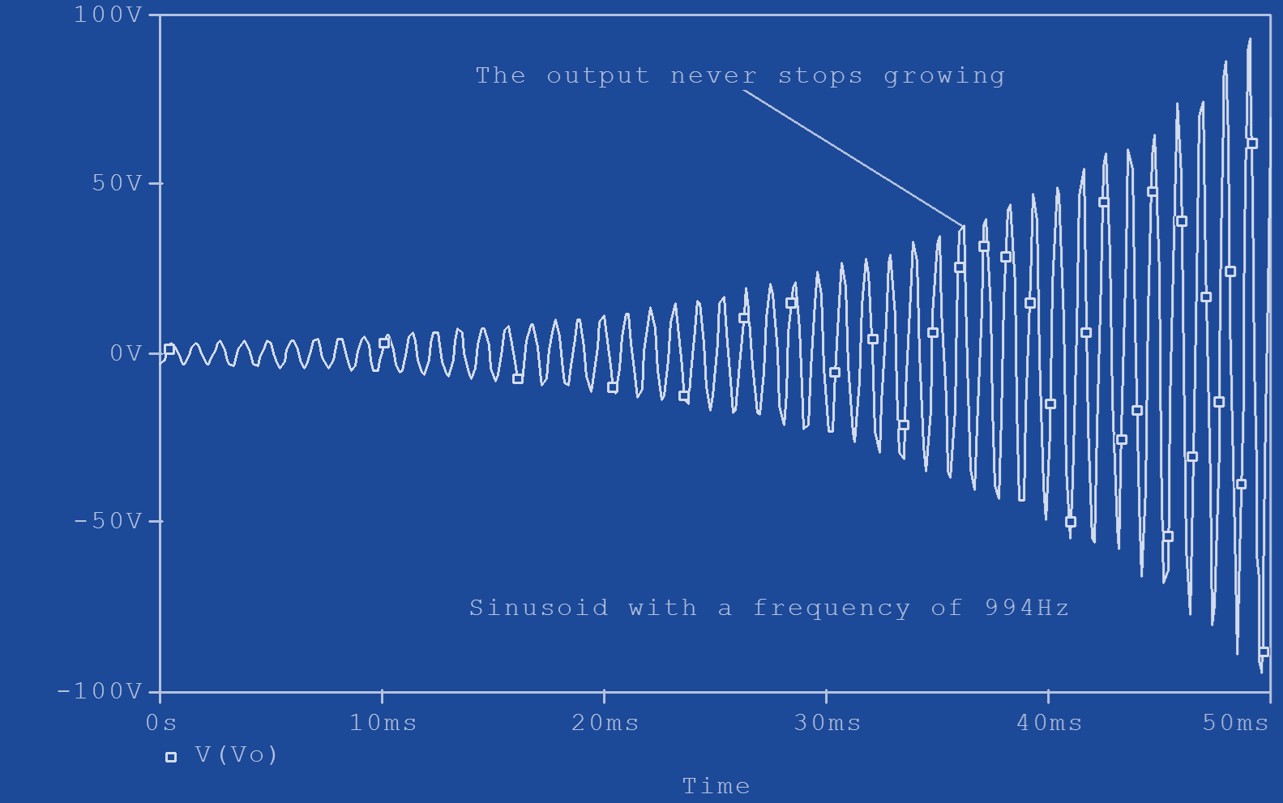

Slide 12
Adding nonlinear limiting device to make sure that Aβ=1, before distortion occurs.
Aβ >1
Aβ =1
start oscillator
sustained oscillations

Slide 13
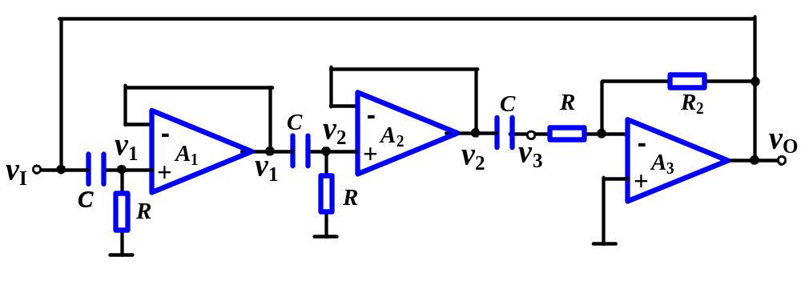
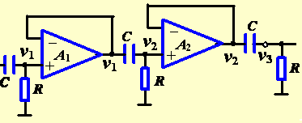
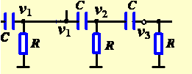
15.2.2. Phase-shift Oscillator
A. Structure
A₁, A₂ are voltage followers to eliminate loading effects.
A₃ gives 180º phase shift, and RC gives another 180º phase shift, total phase shift around loop is 360º.

Slide 14
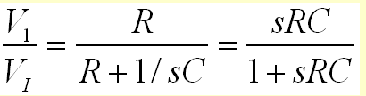

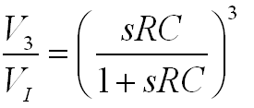
15.2.2. Phase-shift Oscillator
A. Structure

Slide 15


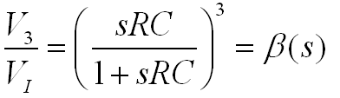
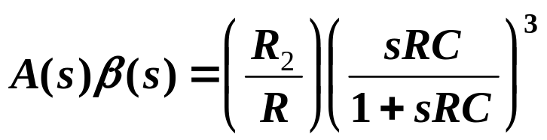
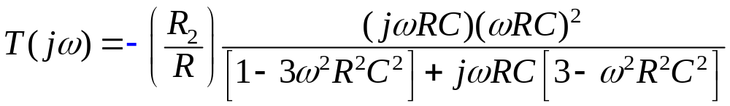
15.2.2. Phase-shift Oscillator
A. Structure
B. Operating
Loop gain
Set s=jω ,

Slide 16
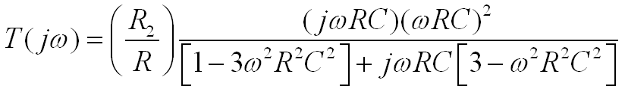

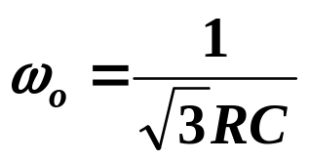
15.2.2. Phase-shift Oscillator
B. Operating
To satisfy T=−1, imaginary component must equal zero.
Oscillation freq.

Slide 17
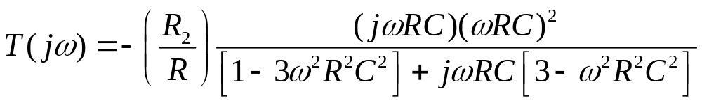
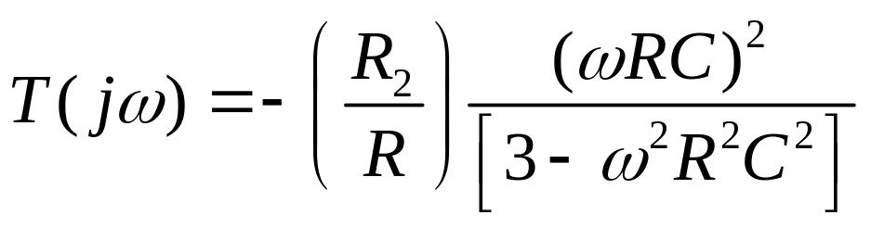
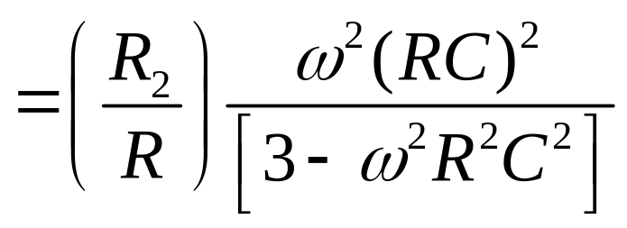
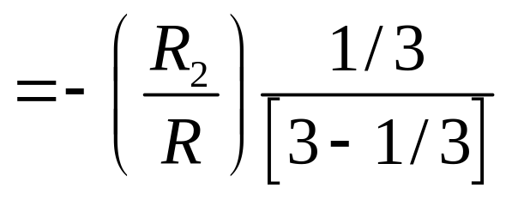
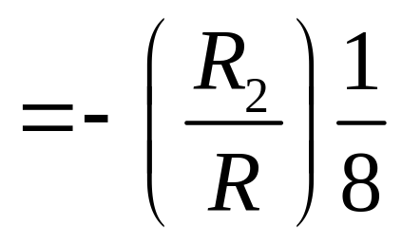
15.2.2. Phase-shift Oscillator
B. Operating
At this freq.

Slide 18
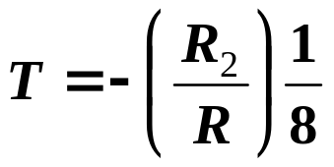
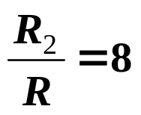
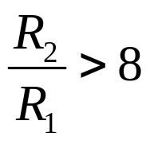
15.2.2. Phase-shift Oscillator
B. Operating
At this freq.
At beginning
to ensure the startup of oscillation

Slide 19
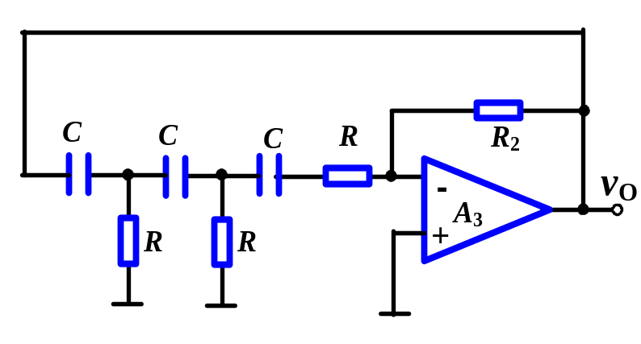
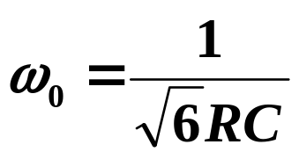
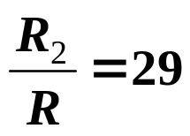
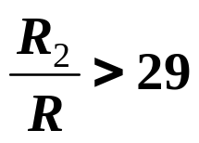
15.2.2. Phase-shift Oscillator
B. Operating
Two voltage followers need not be included. The analysis shows the oscillation freq.
Amplifier resistor ratio must be
At beginning
to ensure the startup of oscillation

Slide 20
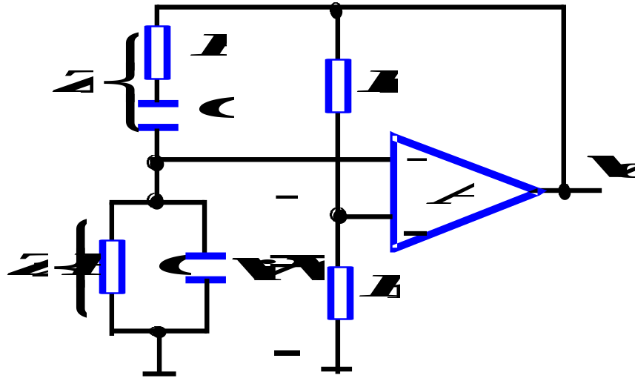
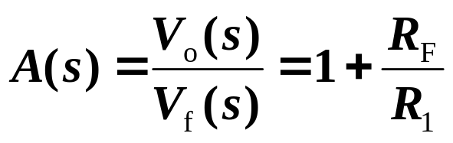
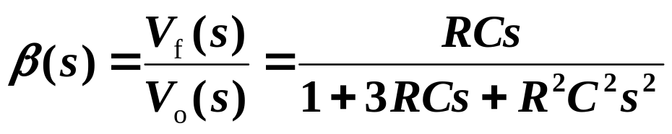
15.2.3. Wien-Bridge Oscillator
A. Structure
Basic amp and feedback network.
A series and a parallel RC networks are connected as freq-selecting network.
B. Frequency-selecting network
Voltage gain of basic amp
TF of feedback network
Substituting s=jω, and assume ω₀=1/RC

Slide 21
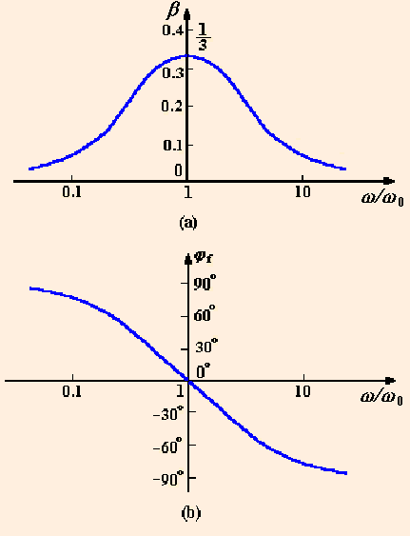
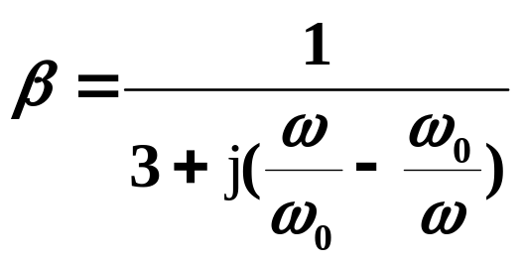
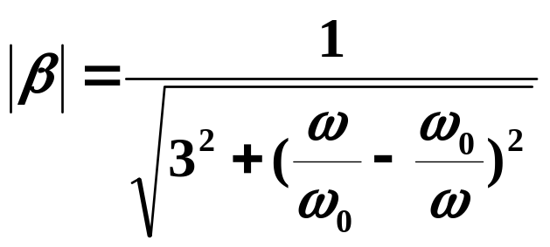
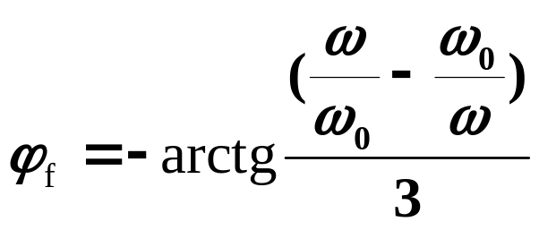
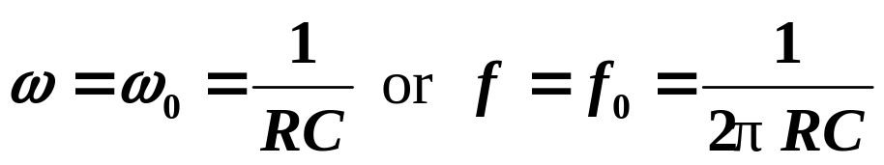
15.2.3. Wien-Bridge Oscillator
B. Frequency-selecting network
Magnitude response
Phase response
When

Slide 22
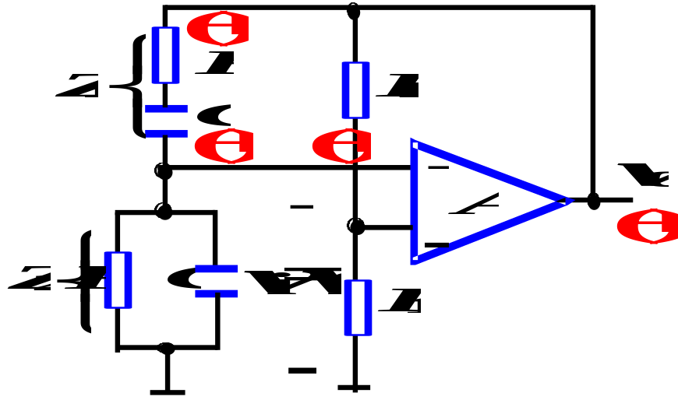
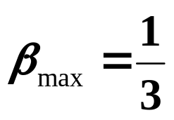


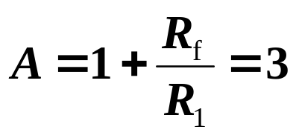
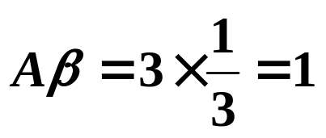
15.2.3. Wien-Bridge Oscillator
C. Operating
When
Max magnitude
Phase angle
Total phase shift is
If voltage gain of basic amp
Then
Circuit can sustain oscillation.
Output is a sine wave , and oscillation frequency is ω_{o} .
Oscillator with RC network can be used to produce signal in the 1 MHz frequency range.

Slide 23
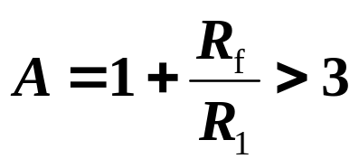

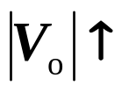
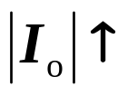






15.2.3. Wien-Bridge Oscillator
thermistor
D. Stabilization
A nonlinear device is introduced
thermistor
start-up
Process of automatic adjustment
Stabilization

Slide 24
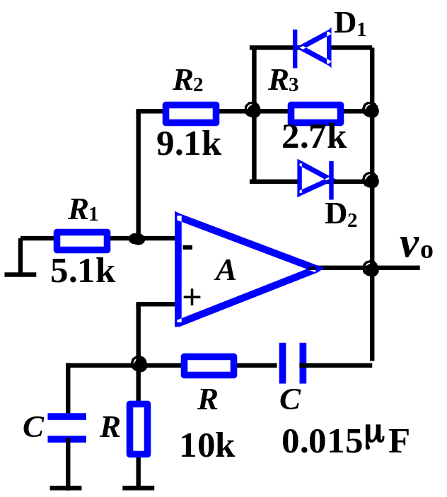
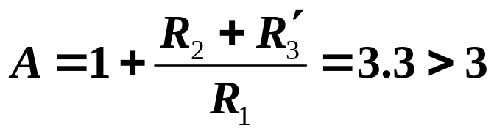
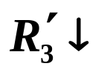
15.2.3. Wien-Bridge Oscillator
D. Stabilization
diodes
At beginning v_{o} is very small, D₁ and D₂ are open.
Where R´₃ is equivalent resistance of R₃ ,D₁, D₂.
When v_{o} becomes large, R´₃ becomes small, v_{o} decreases.
Process of automatic adjustment
Stabilization

Slide 25
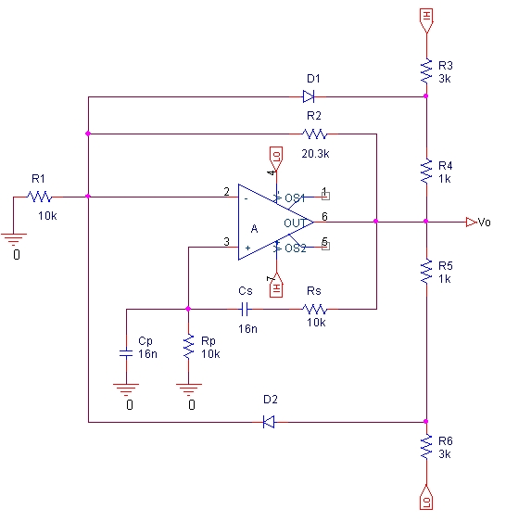

Slide 26


Slide 27

start oscillator and Stabilization

Slide 28


Slide 29


Example 1
Using the condition of phase shift to judge the circuit can oscillate or not, if not, please modify the circuit to make it to oscillate.
Exchange the polarities of A1.
Can not oscillate

Slide 30

Example 1
Exchange the polarities of A1.
Can not oscillate

Slide 31

Example 1
Can not oscillate

Slide 32




Example 1
Can oscillate

Slide 33


Example 2
Connect the line to make the circuit to oscillate

Slide 34
Questions
and
Answers

